Slide 1
Probability and Counting Rules 16 Infographics Deck
Compiled presentation for study, training, and classroom use
1. Module 1: Probability Foundations
• Introduction to Probability in Statistics and Machine Learning
• Probability Experiment, Trial, Outcome, and Sample Space
• Building Sample Spaces: Coin Toss, Dice Roll, and Two-Dice Grid
• Events in Probability: Simple Event vs Compound Event
2. Module 2: Interpretations of Probability
• Three Interpretations of Probability
• Classical Probability: Equally Likely Outcomes
• Empirical Probability: Learning from Observed Frequencies
• Subjective Probability: Expert Judgment and Estimated Likelihood
• Classical vs Empirical vs Subjective Probability
3. Module 3: Probability Rules
• Addition Rule for Mutually Exclusive Events
• Addition Rule for Non-Mutually Exclusive Events
• Multiplication Rule for Independent Events
• Dependent Events and Conditional Probability
• Conditional Probability Using Two-Way Tables
4. Module 4: Counting and Formula Selection
• Counting Rules for Probability
• Probability Rule Decision Map
Overview of all 16 infographics

Slide 2
Module 1: Probability Foundations
4 infographic slides
Section 1 of 4

Slide 3
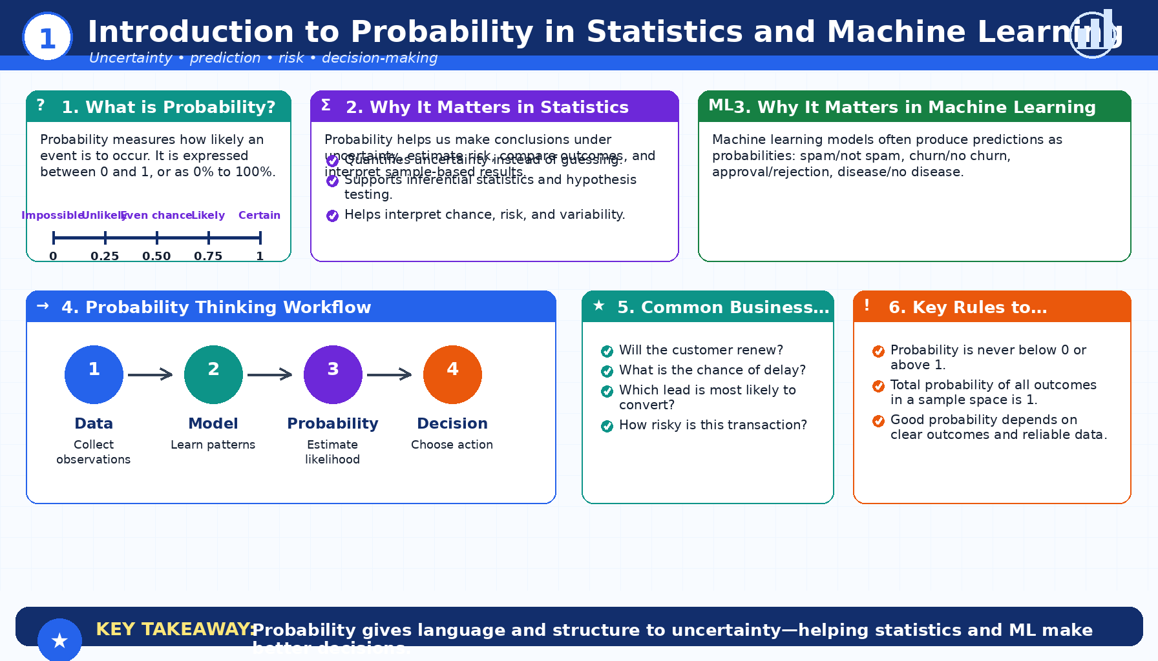
Introduction to Probability in Statistics and Machine Learning
Module 1: Probability Foundations
Infographic 1 of 16

Slide 4
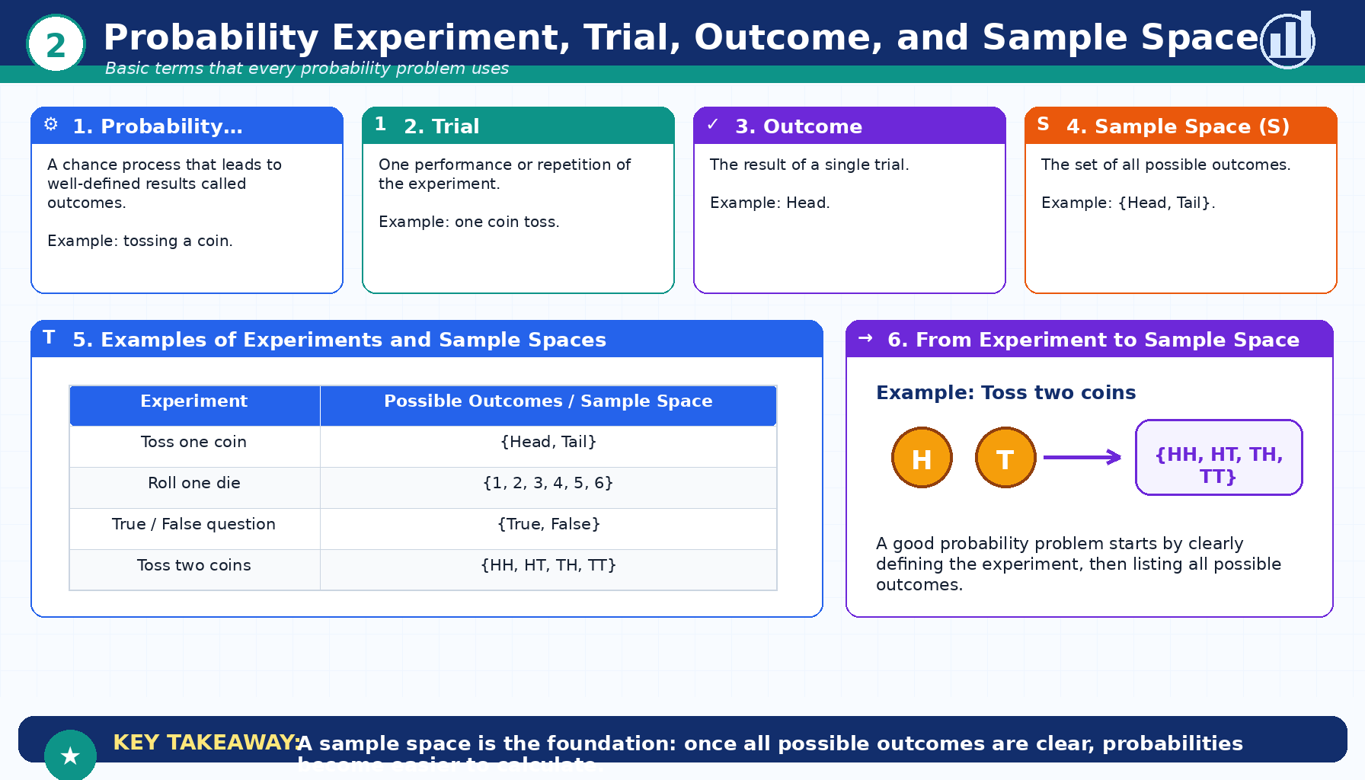
Probability Experiment, Trial, Outcome, and Sample Space
Module 1: Probability Foundations
Infographic 2 of 16

Slide 5
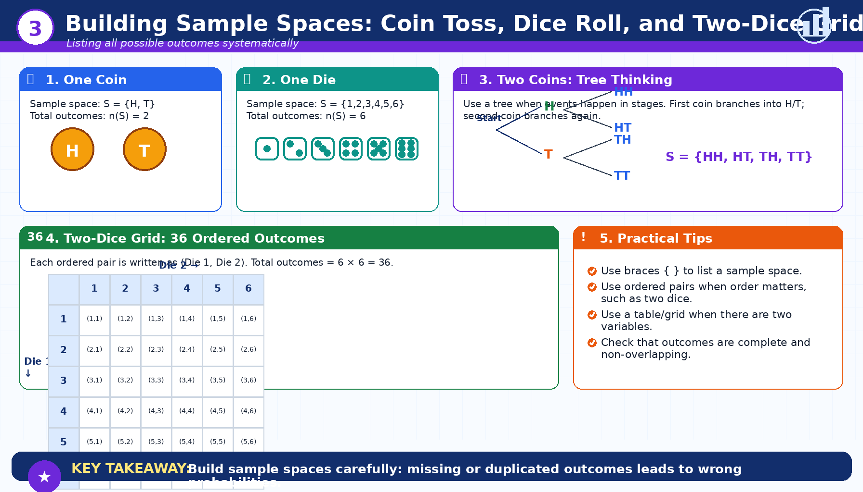
Building Sample Spaces: Coin Toss, Dice Roll, and Two-Dice Grid
Module 1: Probability Foundations
Infographic 3 of 16

Slide 6
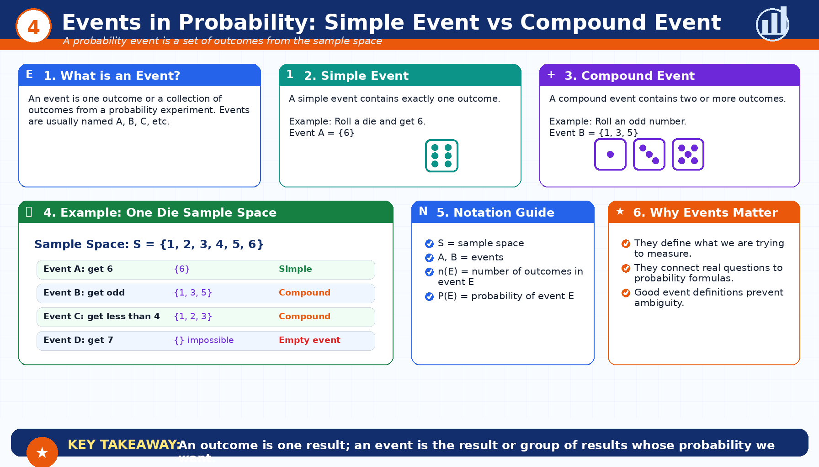
Events in Probability: Simple Event vs Compound Event
Module 1: Probability Foundations
Infographic 4 of 16

Slide 7
Module 2: Interpretations of Probability
5 infographic slides
Section 2 of 4

Slide 8
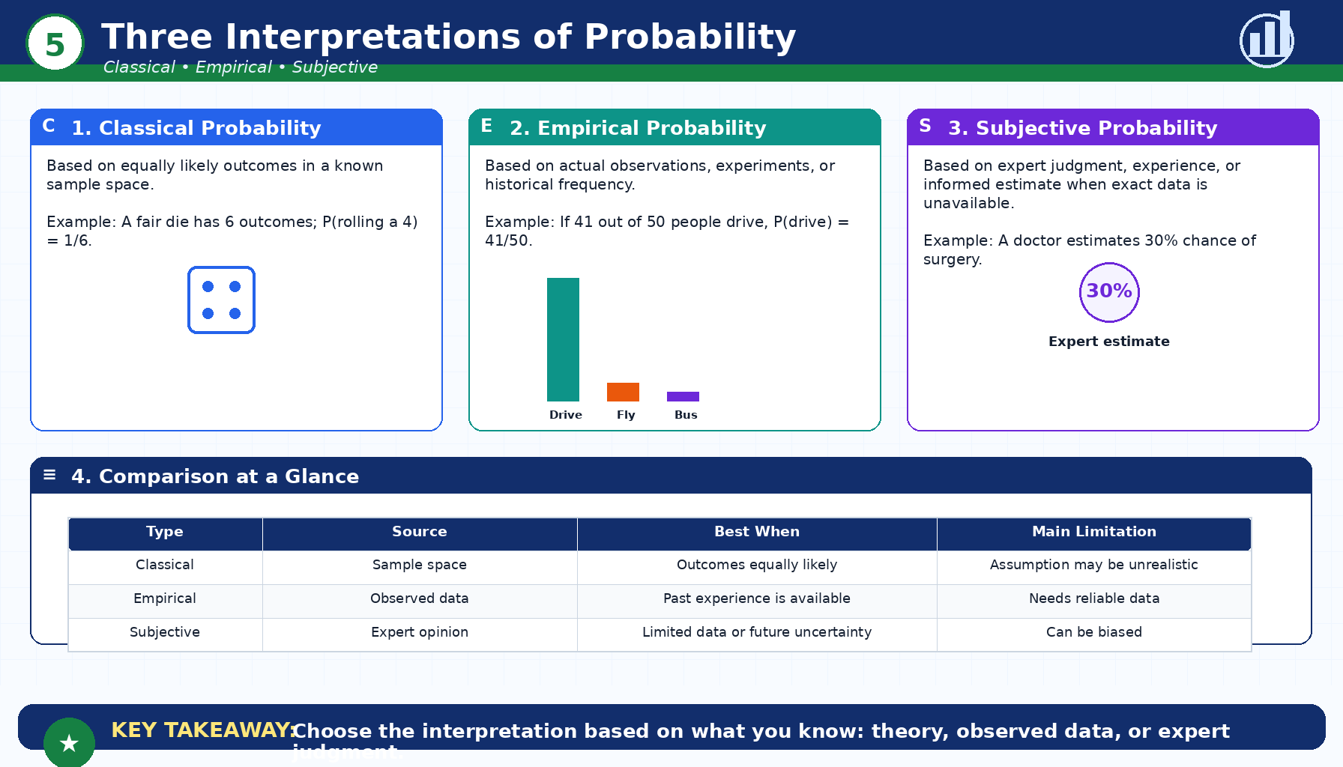
Three Interpretations of Probability
Module 2: Interpretations of Probability
Infographic 5 of 16

Slide 9
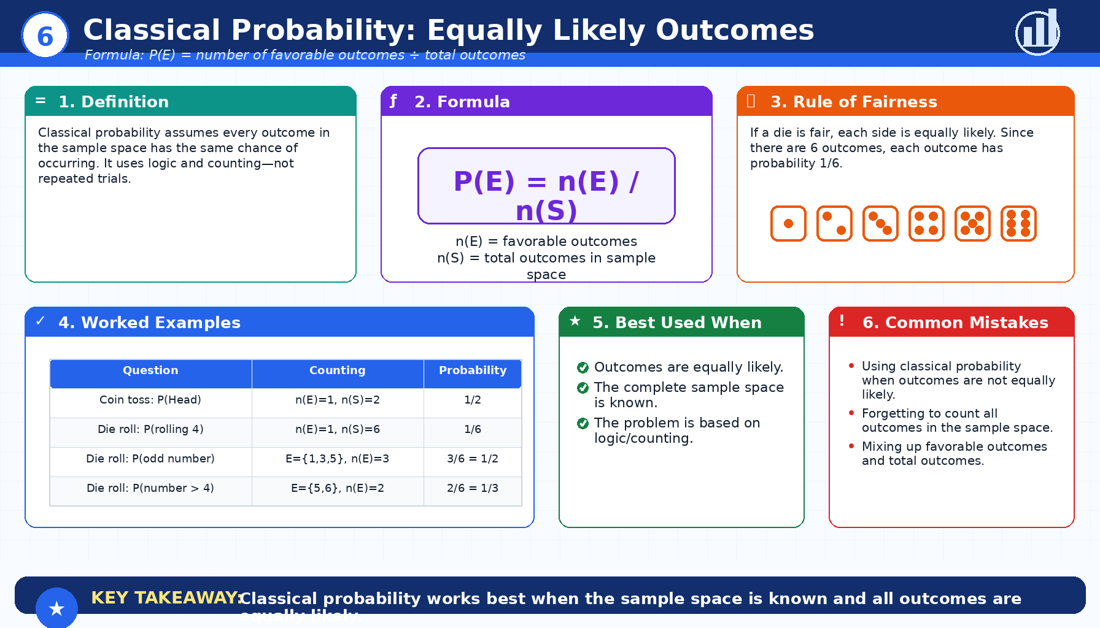
Classical Probability: Equally Likely Outcomes
Module 2: Interpretations of Probability
Infographic 6 of 16

Slide 10
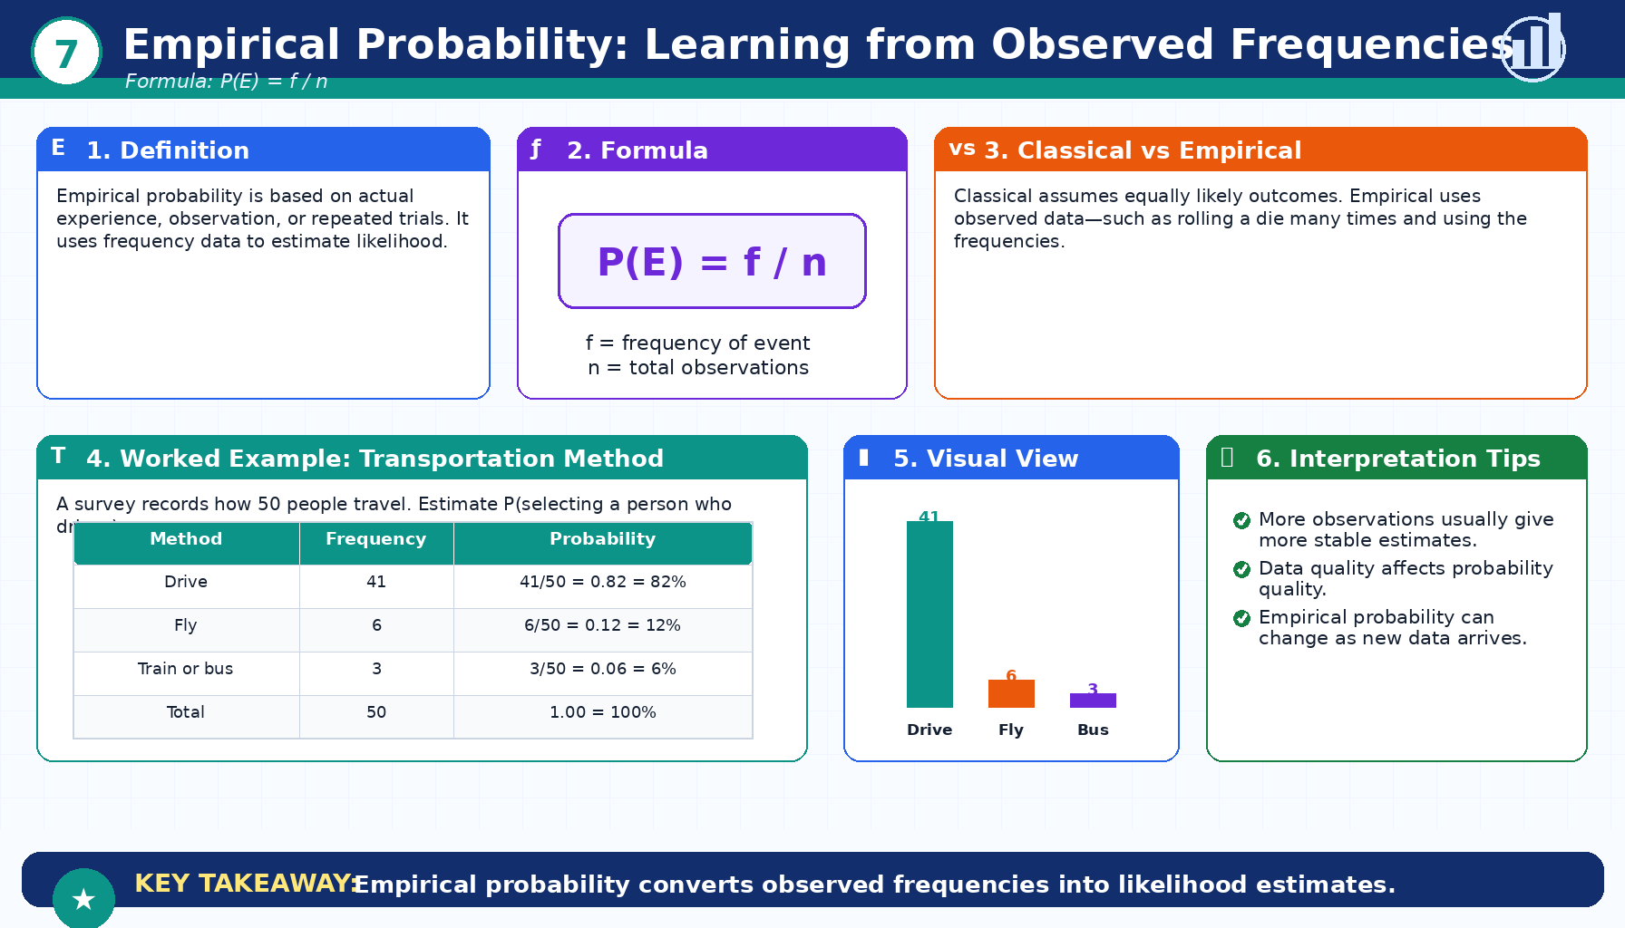
Empirical Probability: Learning from Observed Frequencies
Module 2: Interpretations of Probability
Infographic 7 of 16

Slide 11
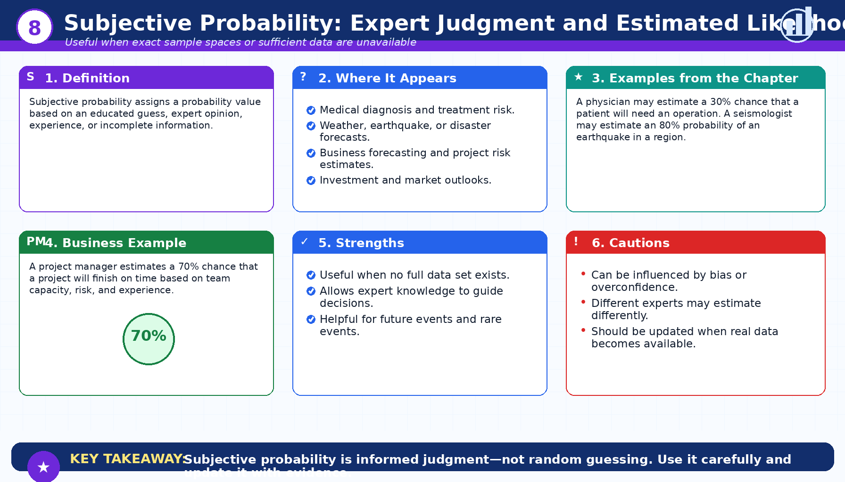
Subjective Probability: Expert Judgment and Estimated Likelihood
Module 2: Interpretations of Probability
Infographic 8 of 16

Slide 12
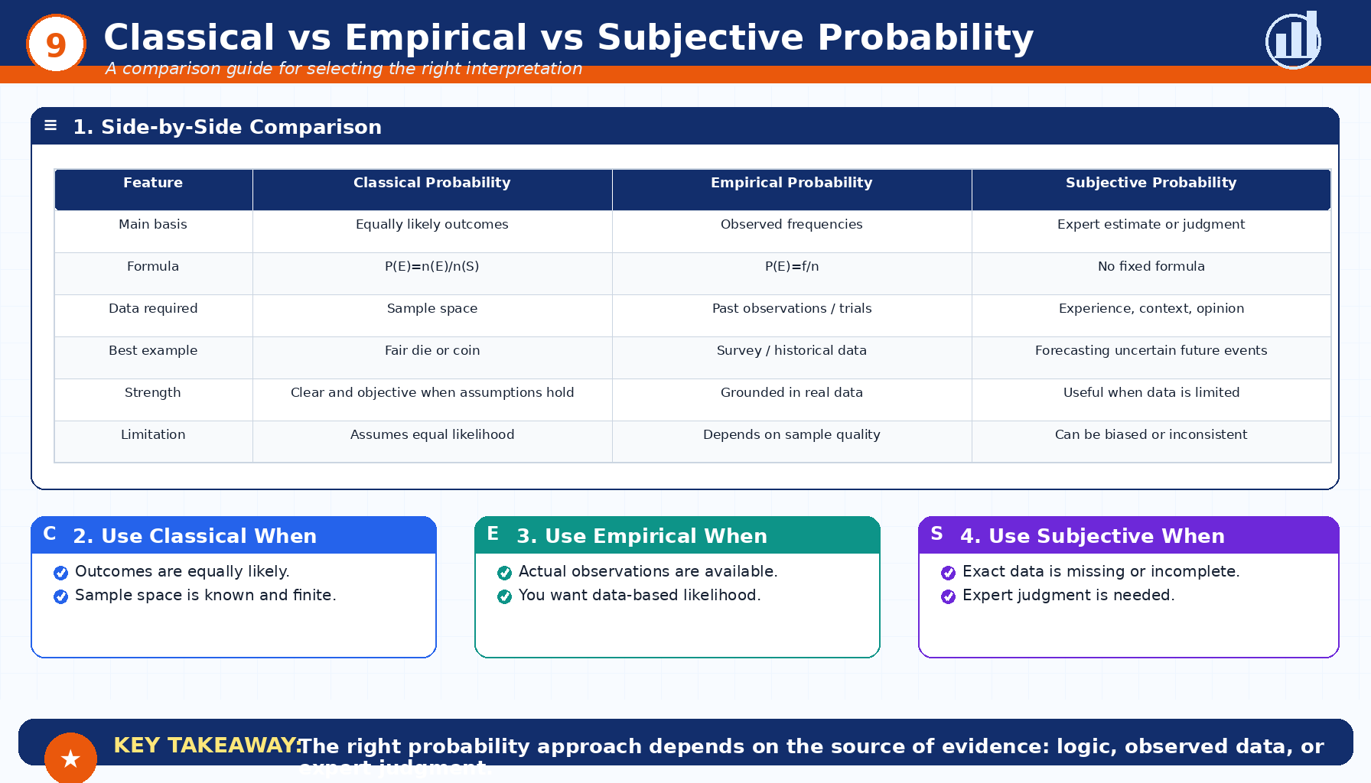
Classical vs Empirical vs Subjective Probability
Module 2: Interpretations of Probability
Infographic 9 of 16

Slide 13
Module 3: Probability Rules
5 infographic slides
Section 3 of 4

Slide 14
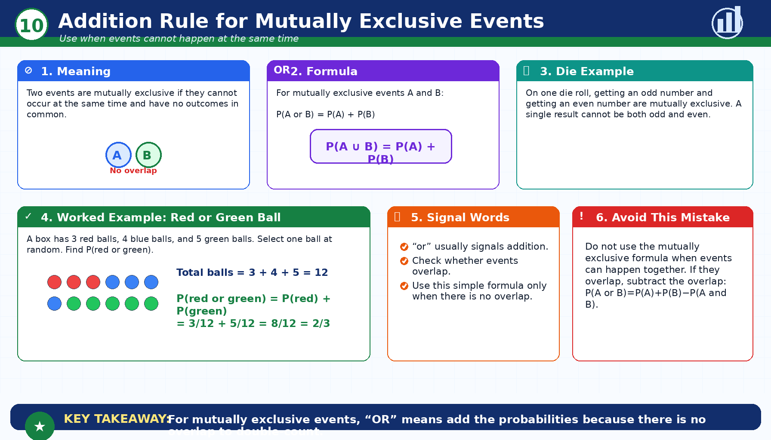
Addition Rule for Mutually Exclusive Events
Module 3: Probability Rules
Infographic 10 of 16

Slide 15
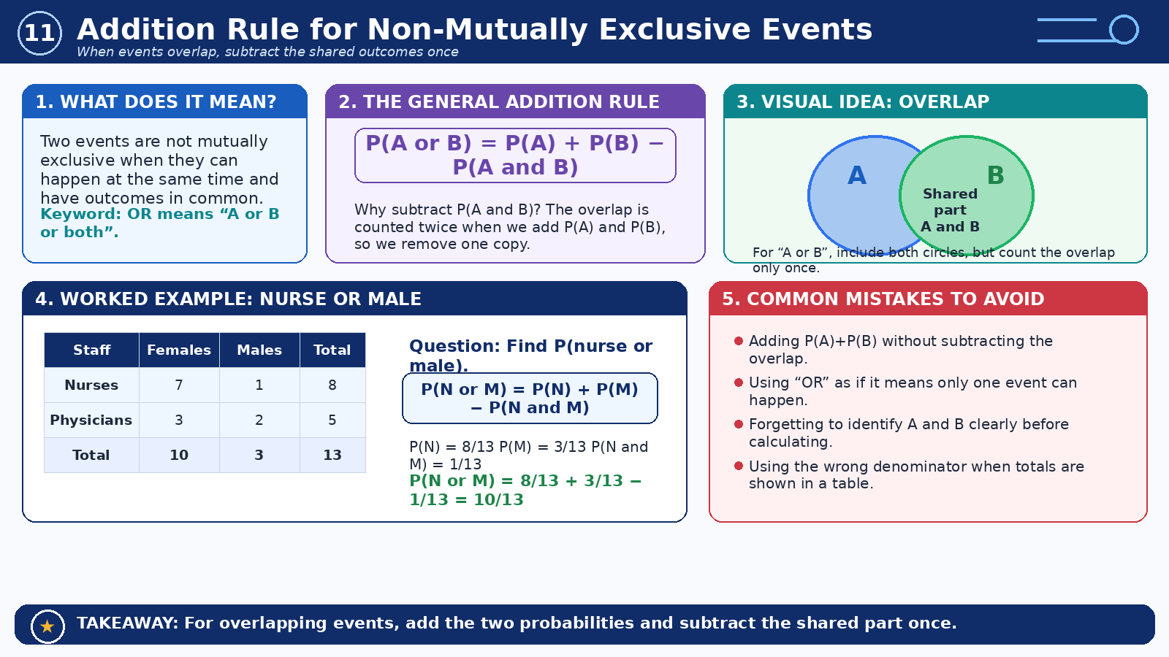
Addition Rule for Non-Mutually Exclusive Events
Module 3: Probability Rules
Infographic 11 of 16

Slide 16
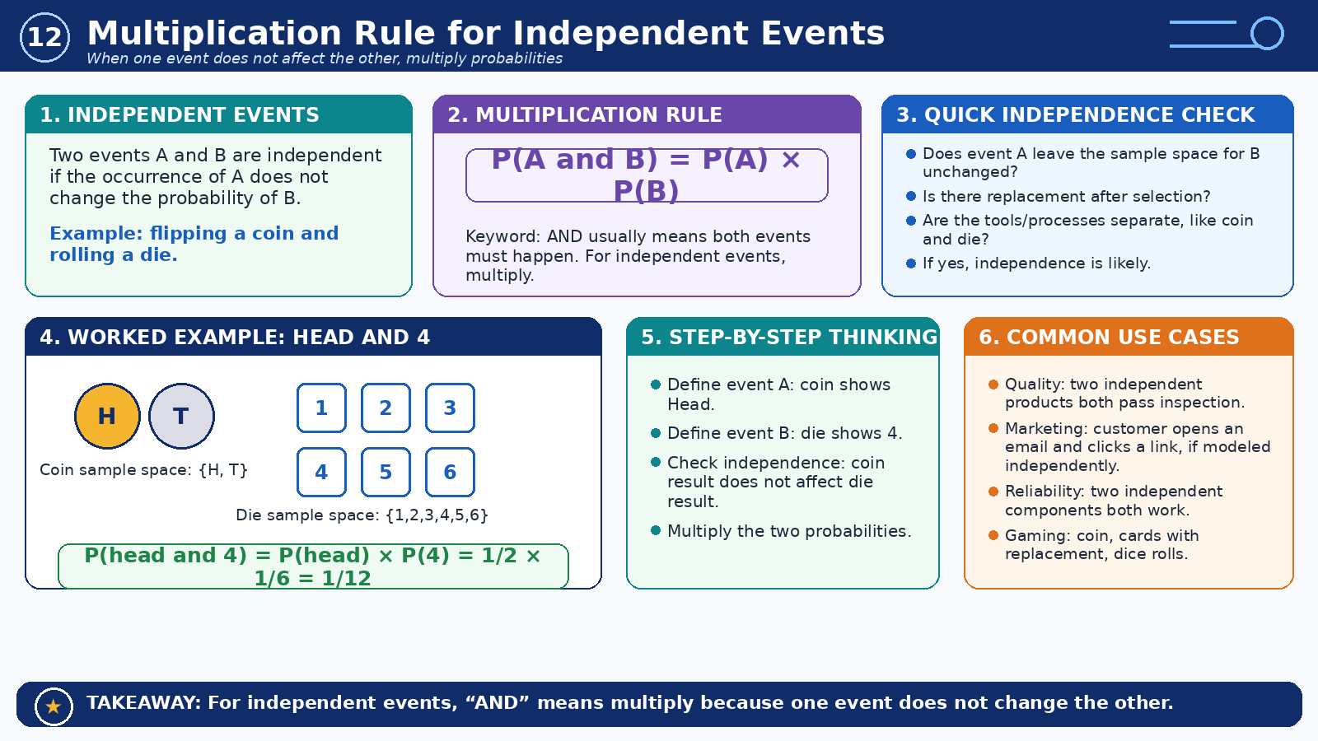
Multiplication Rule for Independent Events
Module 3: Probability Rules
Infographic 12 of 16

Slide 17
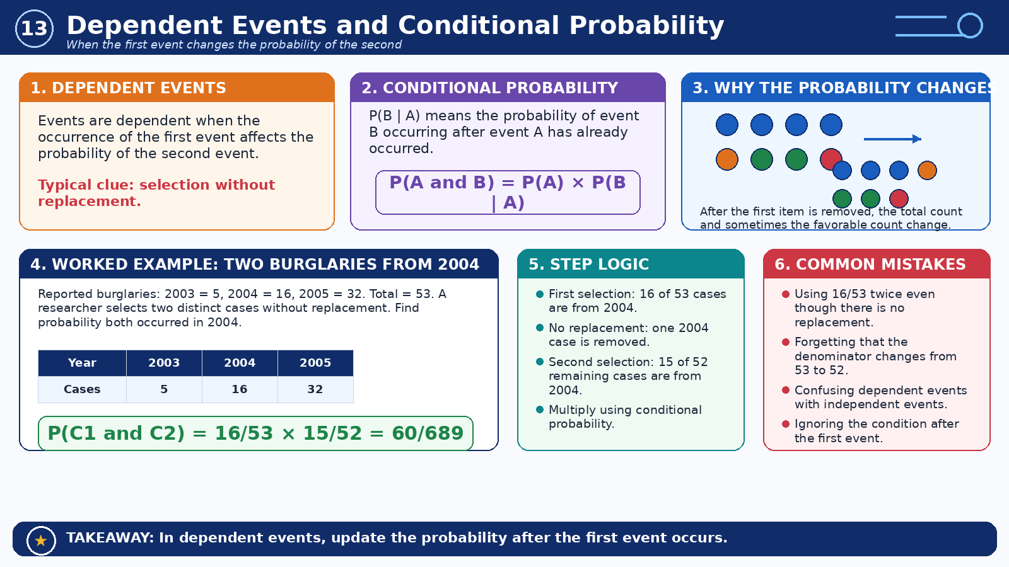
Dependent Events and Conditional Probability
Module 3: Probability Rules
Infographic 13 of 16

Slide 18
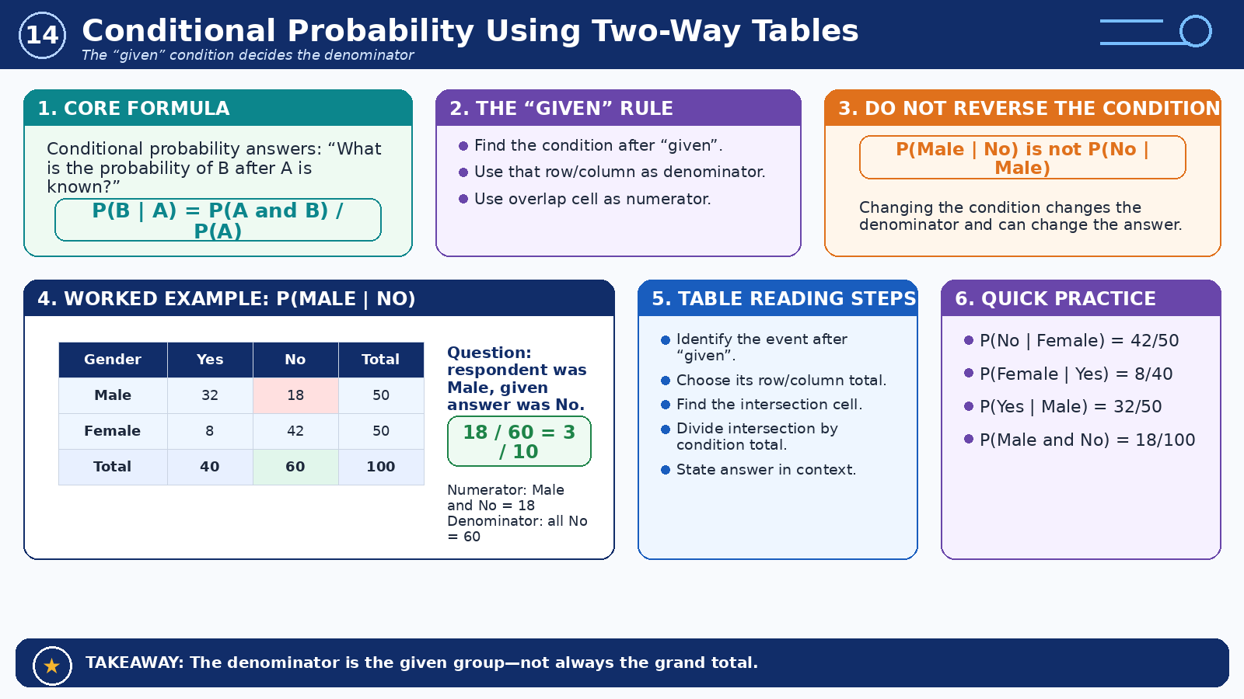
Conditional Probability Using Two-Way Tables
Module 3: Probability Rules
Infographic 14 of 16

Slide 19
Module 4: Counting and Formula Selection
2 infographic slides
Section 4 of 4

Slide 20
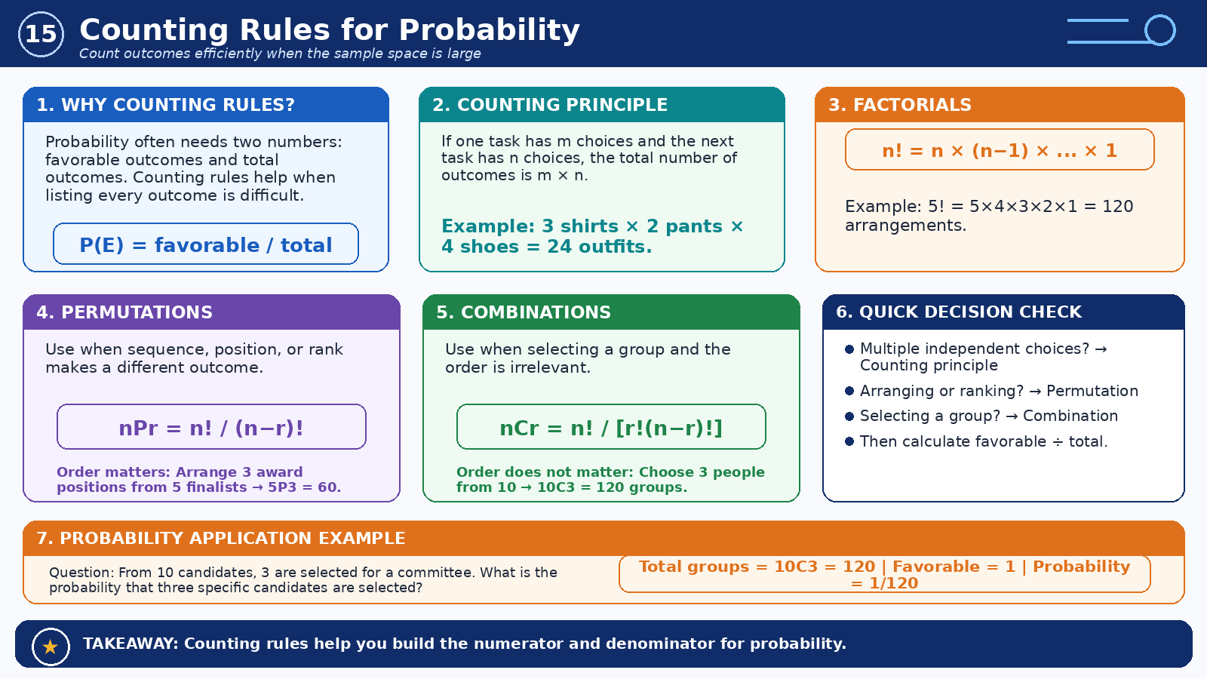
Counting Rules for Probability
Module 4: Counting and Formula Selection
Infographic 15 of 16

Slide 21
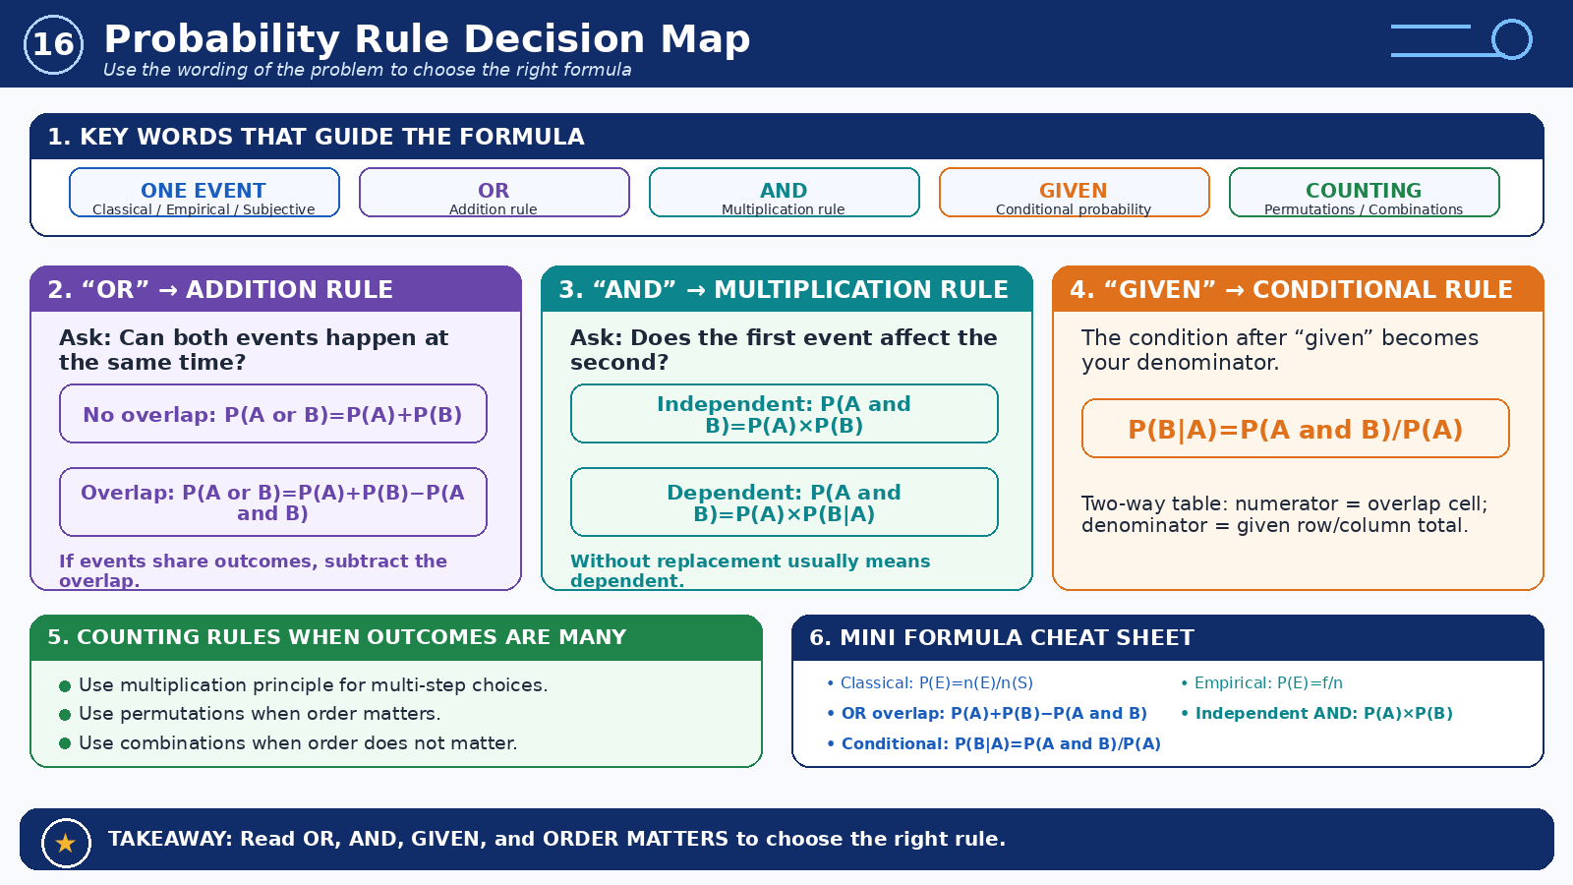
Probability Rule Decision Map
Module 4: Counting and Formula Selection
Infographic 16 of 16

